Slide 2
Email us!
Info@ManateeCountyFAPA.com
ManateeCountyFAPA@yahoo.com

Slide 3
Upcoming Meetings and Trainings
August 6: Training on Sensory Processing Disorders
(Online via Zoom)
September 3: TBD- Previously scheduled as Field Trip to All Star Children’s Foundation, but that is not possible due to COVID. Details on Sept. Training will be announced soon.

Slide 4
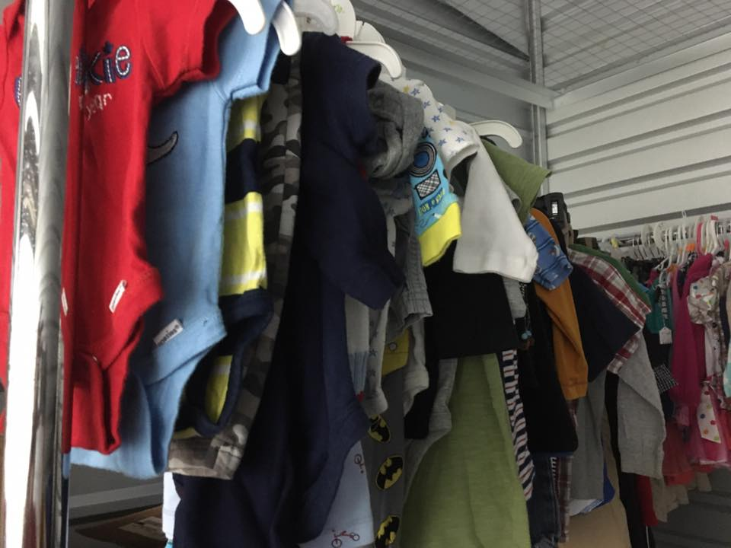
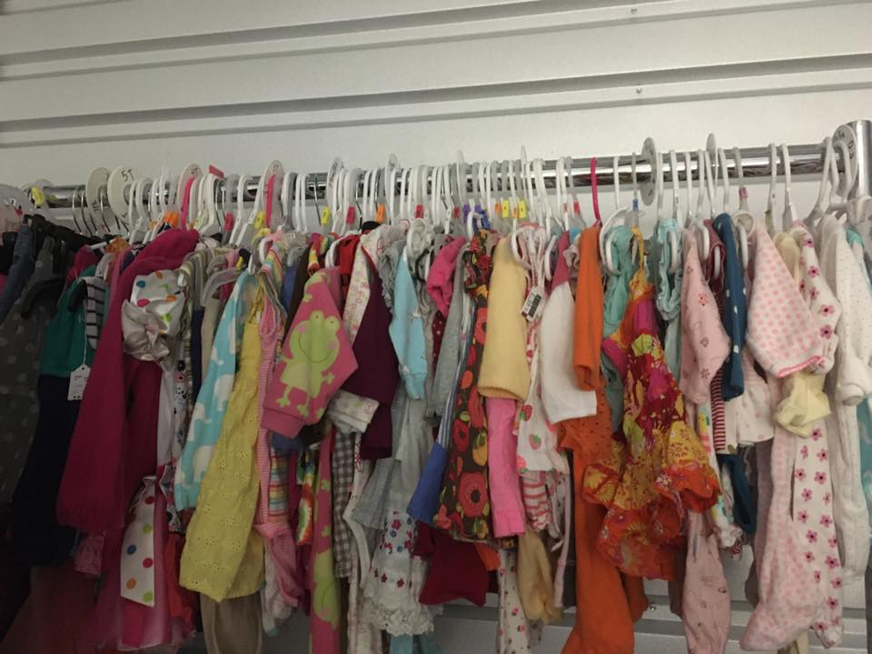
Reminder on MCFAPA Programs & Supports
Welcome Bags, Adoption Congratulation Packs, Luggage, Gently Used Clothing & more!

Slide 5
CODE 1
145

Slide 6
If you have any questions at any time during the presentation, please enter them in the Zoom Chat.

Slide 7
What is a Transition Plan?
A plan that helps a child as he/she moves from one home to another home. It is designed to meet the specific needs of the child and is not a one size fits all template. The purpose is to minimize any additional trauma created by the move.

Slide 8
The Keys to Successful Transition Planning
Evaluate the situation before transition begins
Understand when it is time to start transitioning
Ensure a smooth transition
Be trauma informed

Slide 9
When is a Transition Plan needed?
Anytime a child moves from one placement to another.
That includes any moves such as:
Reunification to biological parents
Movement to a family member
Movement to another foster home or group home
Movement to an adoptive placement

Slide 10
Why are transitions important?
To promote healthy attachments
The way a person leaves a situation affects the way he enters the next.
Unfinished business often hinders the ability to start a new situation.
When a child has closure from a proper transition, they feel more secure in the new surroundings.
Helps a child build trust that not all people disappear from their life.

Slide 11
“When transitions are done suddenly, there is a significant risk of harm to the child.”
Dr Charles H. Zeana, JR., M.D. Institute of Infant and Early Childhood Mental Health

Slide 12
Gaining Perspective
• Every move to a new placement (including the 1st from their biological family) will contribute to a loss of one developmental and one academic year.
• Example: A 17 yr. old child who has moved 5 times may respond emotionally and behaviorally act like a 12 yr old.
• It is only possible for a child to catch up once they feel safe and secure in a placement with caring adults who provide experiences for them to grow self-sufficiently.

Slide 13
Considerations for a Smooth Transition
A gradual transition plan put in place that involves all key people (parents, out-of-home caregivers, GAL, child’s attorney, child (as age appropriate), child’s therapist, parent service providers (if applicable)
Understand the thoughts of the child and child’s therapist about the transition

Slide 14
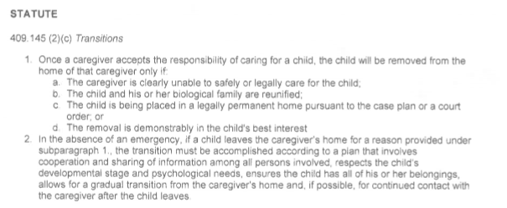
Florida Statute re: Transitions

Slide 15
Considerations for a Smooth Transition- cont.
Introduce the new person to the child in the presence of the current parent figure.
The child should successfully spend increasing periods of time, including unsupervised overnight and weekend visits with the parents or prospective caregiver(s)
The input of the present out-of-home caregivers should be considered. They are the experts on this child.

Slide 16
Considerations for a Smooth Transition- cont.
Have a plan for the child to say goodbye to the out-of-home caregivers and other children and pets present in the home.
The child should have all of their belongings
Where will the change of physical custody take place?
Who will transport the child to the new home?

Slide 17
Considerations for a Smooth Transition- cont.
Are there any upcoming events in the home that would suggest waiting a day or two for placement change of the child?
What is the educational plan for the child? If the child has to transfer schools, can the placement change wait until school is out?

Slide 18
Considerations for a Smooth Transition- cont.
Are there any medical treatments, procedures or appointments for the child that requires education of or follow-up by the new caregiver?
Are all services transitioning with the child?
Is there a plan for continued contact with the out-of-home caregivers after the placement change?

Slide 19
Understanding Trauma
There is trauma in any transition, we must try to reduce the trauma.
Sufficient time for transition
Awareness of events in the child’s life
Best scenario is a written transition plan

Slide 20
Preparing for the move
Current caregiver shares information about the child in a write-up to include:
The child’s typical routine- bedtime, meals, bath time, etc.
Likes and dislikes- food, games, hugs, etc.
Strengths and areas of improvement
Favorites- foods and comfort items
Stressful times and fears
Effective discipline techniques
Hobbies, extra curricular activities, etc.
Anything that will help the new caregiver in caring for the child

Slide 21
Preparing for the move
Trade Pictures
Both families share pictures
Foster family/out of home caregivers provide the child with a photo album and/or Life Book commemorating his or her time with their family
Receiving family sends pictures to current caregivers to hand in the child’s room and for them to talk about the new family (or family they are rejoining in cases of reunification)

Slide 22
Preparing for the move
How to tell the child?:
This should be a team decision made by those that know the child best- foster family/caregiver, therapist, GAL, Case Manager
It should be explained at an age appropriate level.
If possible (and age appropriate), explain the timeframe and steps towards the move
Don’t over promise.

Slide 23
Preparing for the move
When should it occur?:
Weekday or weekend? It shouldn’t be at a time that is rushed.
Allow time to pack all of the child’s items and allow the child to participate in this process, if appropriate.
What is going on in the child’s life at the time of the move? School, little league, birthday party, school events, etc.
When is the best time for the child to say good bye to everyone important to them, including- at school, after school care, day care, extracurricular activities, neighborhood, foster family/caregiver family members

Slide 24
Preparing for the move
Who will take the child?:
Ideally the current foster parent/caregiver should take the child to the new placement or to meet the new caregiver in a neutral location.
Does the Case Manager and/or GAL need to be present?
Does the Child Placing Agency need to be involved to support the foster parent/caregiver? Very important- don’t discount how the transition will affect you! Remember our training on processing grief and loss in foster care.

Slide 25
Preparing for the move
The Move:
This will be an emotional time for everyone involved, but the big people need to put on a happy face for the child.
If appropriate, take pictures.

Slide 26
Preparing for the move
After the move
Ideally everyone will stay in touch- visits, back up baby sitter, phone calls, pictures
The sending parent needs to respect the boundaries of the receiving parent.
Celebrate that you made a difference in the child’s life.
Acknowledge your needs for emotional support and self-care
Do Something for you
Recognize the impact you made
When ready, accept another placement

Slide 27
Child Centered Transitions (QPI Florida)
http://centervideo.forest.usf.edu/qpi/transitions/transitions.html

Slide 28
When Children Move…We Can Do Better! (QPI Florida)
http://centervideo.forest.usf.edu/qpi/bettertransition/bettertransition.html

Slide 29
Important Reminders:
No matter the length of time, a goodbye or acknowledgement of the stay is necessary.
When reunifying, the child will need time to rebuild and reawaken the attachment with the parent.
The child needs to adapt to transitioning away from the foster parent/caregiver.
The child needs to see the parent and foster parent/caregiver interacting in a positive way.

Slide 30
Acknowledge the Challenges of Long-Distance Transitions:
Send pictures and letters
Frequent phone calls and/or video visits
Talk positively about the transition. Explain the differences to the child (weather, type of house, who lives in the new home, etc.)
If possible, in-person visits should take place before a long-distance move.
If you pray, say a prayer for the receiving family.

Slide 32
Additional Resources
http://centervideo.forest.usf.edu/qpi/supportchild/start.html
http://centervideo.forest.usf.edu/qpi/2015QPIMINICONFERENCE/transitions/start.html
http://centervideo.forest.usf.edu/QPI/cali/GrievingInf/GrievingInfants.html
http://centervideo.forest.usf.edu/video/summit19/cctransitionplans/start.html

Slide 33
CODE 2
159

Slide 34
To receive a certificate for in-person Training Hours email your full name, licensing agency and both codes to:
Info@ManateeCountyFAPA.com or
ManateeCountyFAPA@yahoo.com

